Slide 1

Learn - - Math
By:Eric Sullvian
Tauseef Pirzada
Leonid Melnikov

Slide 2

Introduction
We are Andrews Honor Squad*
Members:
Eric Sullivan
Tauseef Pirzada
Leonid Melnikov
*no longer self proclaimed

Slide 3

What is Learn -2- Math
Math tutor software
Helps teach kids from Pre K – Grade 4 valuable math skills that they will use throughout life
A fun tutoring software that offers rewards for completing sections
Who doesn’t like stickers

Slide 4

Goal
Easy to use interface that’s primarily used by kids
Teaches the correct information
Make it fun to use
Have a theme

Slide 5
Overview
Intuitive GUI that’s easy to use for kids
Fixed size of 800x600 to ensure it will run on a variety of screens
Programmed in java to support use on different systems
Utilizes MySQL database to store data
Sticker Reward system

Slide 6
GUI overview
Designed to be easy to learn
Consistent layout
Divided into user section and system section
Consistently Fewer than 7 items per area to avoid overwhelming

Slide 7

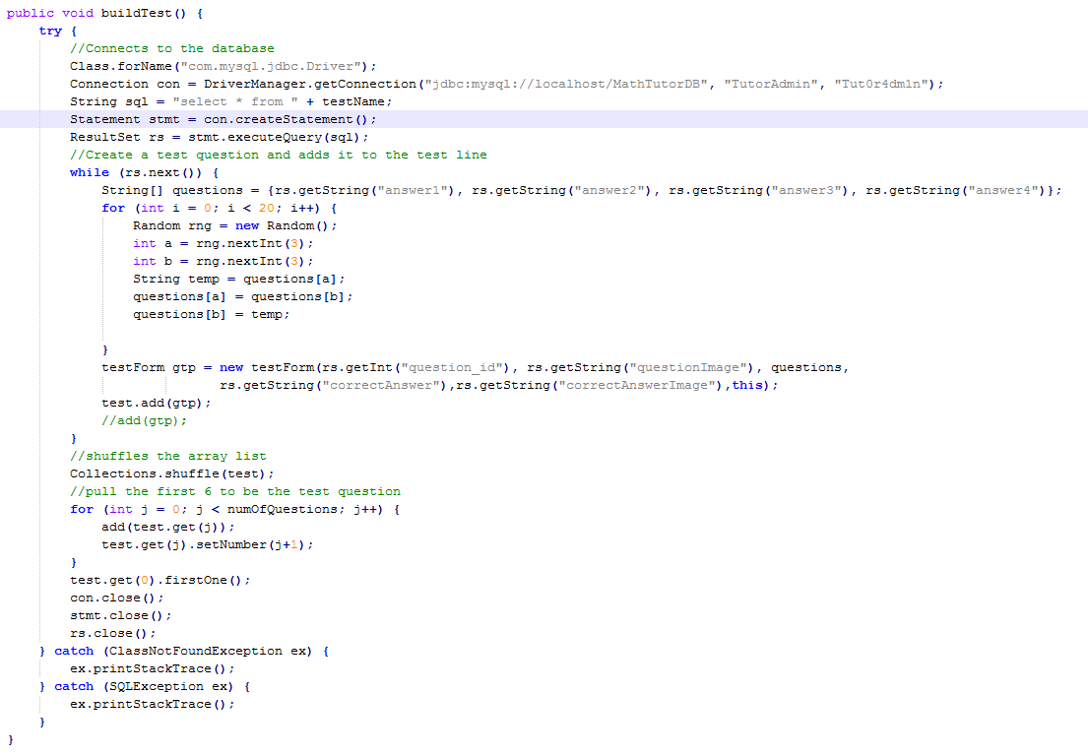
Build test

Slide 8
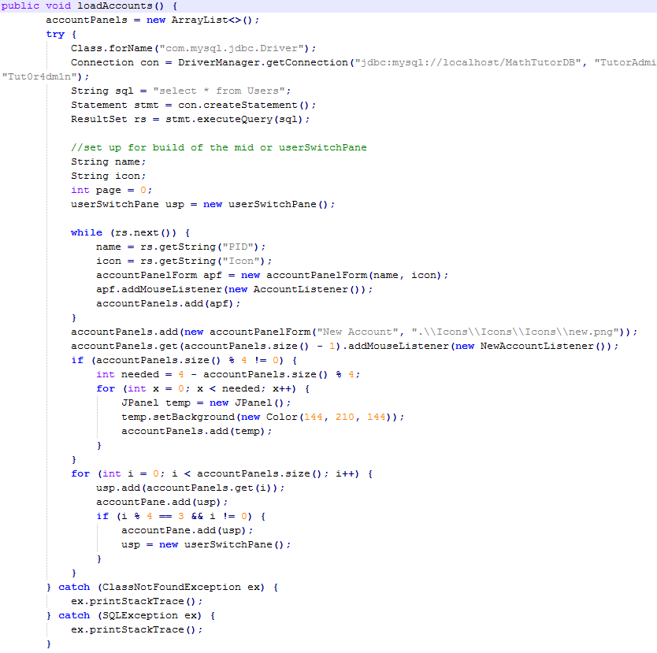

Load accounts

Slide 9

Final words…
To be added
Video tutorials
Full screen mode
More modules
DEMONSTRATION!

